Slide 1
Iris Van der Veken
Responsible Jewellery Council

Slide 2
Who we are
2005
Established
1,200+ members
907 certified
Large & small businesses
Over 10,000 premises
Over 320,000 employees
Diamonds, gold, coloured stones, silver, platinum
Harmonisation of similar industry standards
Third party assurance

Slide 3
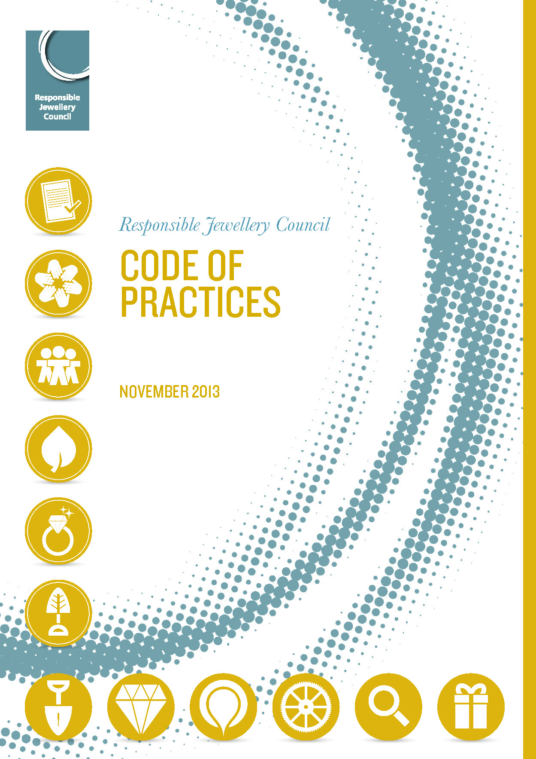
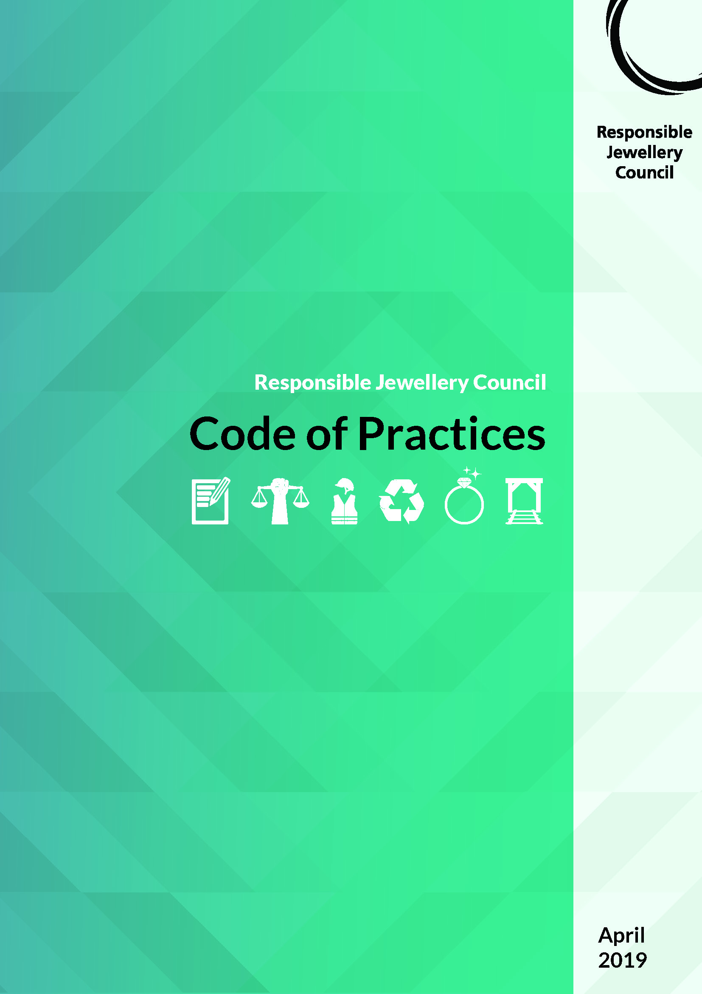
JOIN RESPONSIBLE JEWELLERY COUNCIL
RJC CODE OF PRACTICES
General requirements
Responsible supply chains, human rights and due diligence
Labour rights and working conditions
Health, safety and environment
Gold, silver, PGM, diamond and coloured gemstone products
Responsible mining
- SDG multi-stakeholder Strategic Taskforce
United Nations Global Compact Partnership
Embedding the SDGs into organisation business strategy and policies through the Code of Practices
17 Sustainable development goals

