Slide 1



Responsible Jewellery Council
ASSURANCE, GROWTH, CONFIDENCE
ANDREW BONE
RJC Executive Director
Vicenzaoro – The Jewellery Boutique Show
Sunday 22 January 2017

Slide 2

The RJC Vision and Mission
Our Vision is a responsible world-wide supply chain that promotes trust in the global fine jewellery and watch industry.
Our Mission is to be the recognised standards and certification organisation for supply chain integrity and sustainability in the global fine jewellery and watch industry.
Notes:
Founded in 2005, we are an international standards setting and certification organisation for the fine jewellery and watch industry.
Created for industry, by industry to promote consumer confidence in the diamonds, gold and platinum group metals supply chain from ‘Mine to Retail’.
RJC Certification is the industry’s recognised standard for supply chain due diligence and integrity.
The RJC creates opportunities for members to benchmark management systems against industry best practice
RJC regularly revisits its mission, vision and values as the organization grows to ensure were are inclusive of all issues that affect the mine to retail pipeline.
This slide was approved by the RJC board at its AGM in 2013 and will be reviewed through 2016.

Slide 3






The RJC’s Road to Success
Unique standards organisation
International Recognition
Consistent Membership growth
Increase in RJC Certifications
Ongoing Monitoring & Evaluation
Notes:
Unique standards organisation
Industry thought leader with unrivalled standards for the entire jewellery supply chain
International Recognition
Internationally acclaimed and accepted as evidence of responsible business practices
Consistent Membership growth
Approximately 30% average growth in membership every year since 2010
Increase in RJC Certifications
A consistent increase in RJC Certifications granted every year since the launch of the 2013 Code of Practices, indicates both its importance and stature within the industry
Ongoing M&E
Continuously analyse trends, successes and challenges to adjust strategies and priorities

Slide 4

RJC Membership Benefits
Join a Community of Confidence
Demonstrate Due Diligence
Manage Your Risk; Protect Your Reputation
Consumer Assurance
Improved relations within the industry
Get noticed; Create Awareness
Stay ahead of Legislation
Notes:
RJC Members join a global community of confidence
It provides consumers with assurance that they are purchasing precious items from a company that puts social performance hand in hand with the quality of the product.
RJC Membership raises awareness of your commitment to responsible business practices
Being an RJC Member not only helps you to demonstrate due diligence, but it also helps you to manage risks as well as stay ahead of legislation.

Slide 5





RJC Membership in Figures
935
66
MEMBERS
593
CERTIFICATIONS
8,054
COUNTRIES
PREMISES
379,867
EMPLOYEES
Up to 19 January 2017
Notes:
Updated on 19 January 2017
Membership growth: Year on year -

Slide 6
RJC Membership in Figures

Slide 7
A spotlight on RJC Certification in Italy
Certified Italian facilities, per forum
177 facilities covered by COP Certification
(25% increase since Jan 2016)
7 Member are COP and CoC Certified

Slide 8

RJC standards review
RJC CODE OF PRACTICES (COP)
Review period starts Q2 2017
Public and Member consultation
Release in Q4 2018
CHAIN-OF-CUSTODY STANDARD (COC)
Review underway from Q1 2016
Public and Member consultation
Release in Q4 2017
3. COLOURED STONES/SILVER
Planned to dovetail with COP release
Sector outreach is underway
Notes:
We following ISEAL Codes of good practice in standard setting (we get audited). Standard outlines practices that follow 10 Credibility Principles:
incl Transparency, accessibility, relevance, engagement…
In accordance, standards are reviewed every 5 years – they are live documents
Review process involves public consultation and engagement with membership to ensure relevancy and applicability. Process takes 18 months generally from gap analysis to final publication.
We have 2 standards:
1. COP is management systems and covers the range of env & social issues that are material for the jewellery supply chain. It is mandatory (within 2 years), re-certification every 3 years.
2. CoC which is only for precious metals and is about the flow of material through the supply chain.
We have already started the review of the CoC .
Preparing for COP review – the 2nd review to be carried out. This will take place largely through 2017 to 2018.
An important part of the COP review is an expansion of scope to include coloured stones.
Already done engagement an analysis on what this will look like.
Standards Committee oversees the review of the standards. 28 people – ½ from 14 RJC fora
(to ensure spread of representation across supply chain) and ½ from non-industry.
This group makes the recommendations to ExCo on changes to the standard.
Members will be informed of the review process (email campaigns, newsletter) and will be invited
to being involved in consultation.

Slide 9

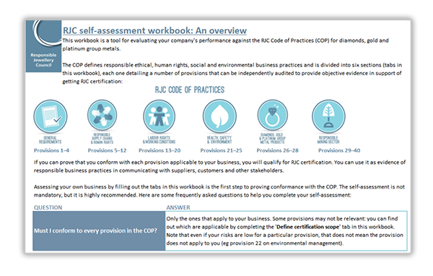
New and improved self-assessment
Notes:
Launching on Monday 23 January 2017
RJC has listened to our members and we spent the latter half of 2016 revising the
self-assessment workbook to make it more user friendly
We’ve revised the format to make it cleaner and more straightforward to use
We’ve added guidance to help members/you understand the provisions and the
requirements in the Code of Practices
We’ve allowed members/you to identify their/your company’s activities beyond
the RJC designated forums, making the questions even more specific
We’ve built-in a corrective action template for members/you to close out their/your
non-conformances before their/your audit
We’ve worked behind the scenes to make sure the mechanics work seamlessly, making
it easier to work with the workbook in its excel format

Slide 10


Scope expansion: Coloured Stones
Notes:
Earlier this year we announced a review of our scope to include coloured gemstones. An expansion of its material scope, which currently includes diamonds, gold and platinum group metals, is the focus of a major study that was launched in Q1 2016.
There has been an enthusiastic response from our valued membership, industry and external parties.
The Standards work stream under the management of Anne-Marie Fleury, Standards and Impacts Director, has struck a multi stakeholder task force that also includes Gaetano C as special advisor, to undertake this work.

Slide 11


La ringrazio tanto
www.responsiblejewellery.com
info@responsiblejewellery.com
Andrew Bone
RJC Executive Director

