Slide 1
UL SERVICES FOR JEWELRY
CIBJO – VicenzaOro January
January 22, 2017
Daphne Guelker, Senior Specialist – Responsible Sourcing, UL Consumer and Retail Services
Francesca Angeloni, Business Development Manager – Europe, Jewelry and Watch, UL Consumer and Retail Services

Slide 2
Agenda
About UL
Jewelry Division
RJC Auditing Process
Resources
UL Apps

Slide 3
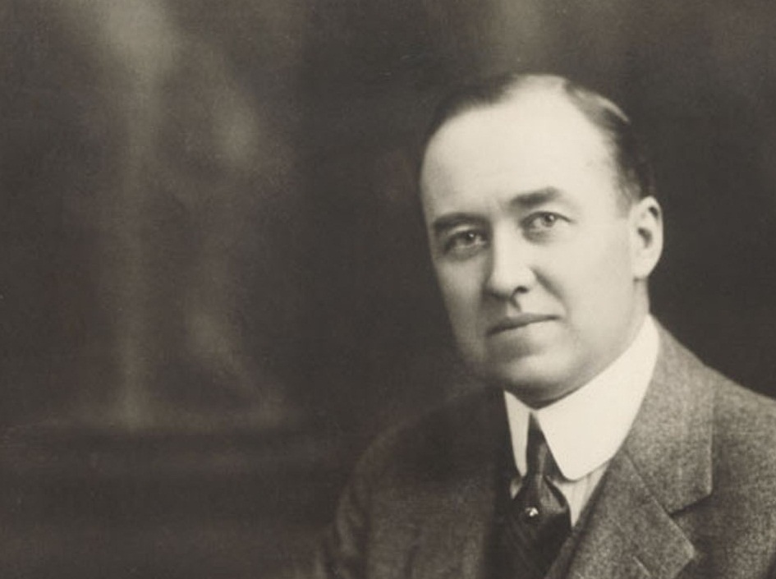

WORKING FOR
A SAFER WORLD
1894
SINCE
THE PRINCIPLES AND VALUES ESTABLISHED BY OUR FOUNDER
DRIVE EVERY DECISION WE MAKE
UL founder William Henry Merrill following 1893 Chicago World’s Fair
3
Notes:
If there is one thing you should know about UL, it’s that we are driven by our mission of working for a safer world.

Slide 4
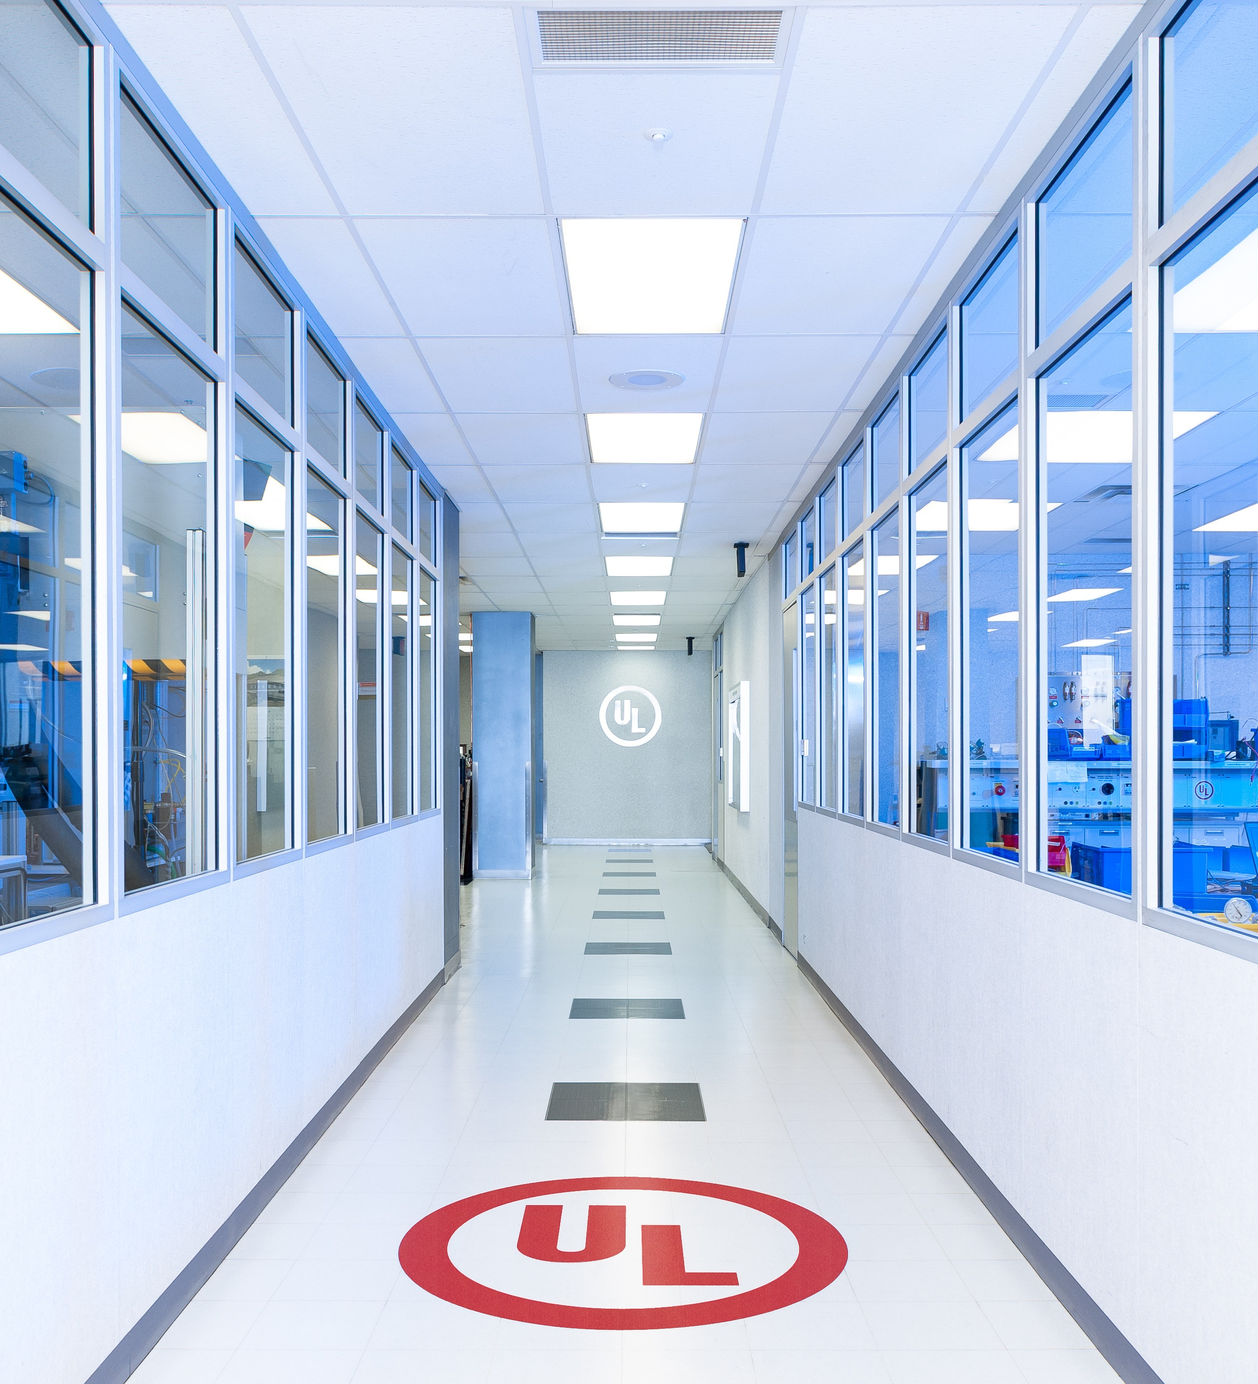
About ul
UL is the Leading Voice for Global Safety.
Since 1894, the mission of UL Underwriters Laboratories has been "working for a safer world," which is at the core of everything the company does.
Notes:
For more than a century, UL has employed exacting scientific processes and the highest ethical principles to deliver trusted results. Today, we are still focusing on the next generation of safety challenges, helping new geographies, new industries and new stakeholders create safer living and work environments.

Slide 5

ABOUT UL
22 BILLION
UL MARKS
APPEAR ON
PRODUCTS
ANNUALLY
OVER
96,000
1 BILLION
CONSUMERS
GLOBALLY
WERE REACHED
BY UL WITH
SAFETY
MESSAGES
PRODUCT
EVALUATIONS
CONDUCTED
BY UL
1,614
170
>12,000
104
CURRENT STANDARDS
FOR SAFETY PUBLISHED
BY THE UL FAMILY OF
COMPANIES
FACILITIES IN
THE UL FAMILY
OF COMPANIES
EMPLOYEES IN
THE UL FAMILY
OF COMPANIES
COUNTRIES WHERE
UL CUSTOMERS
ARE LOCATED
Notes:
Through its network of over 10,000 employees and more than 150 laboratories and inspection centers, UL advances safety through careful research and investigation, helps prevent or reduce loss of life and property, and promotes safe living and working environments for all people.
In 2014, nearly 22 billion UL safety certification marks appeared on products around the world, and UL’s safety messages reached more than 1 billion consumers in Asia, Europe, and North America alone.
UL certifies, validates, tests, inspects, audits, and advises and trains.

Slide 6
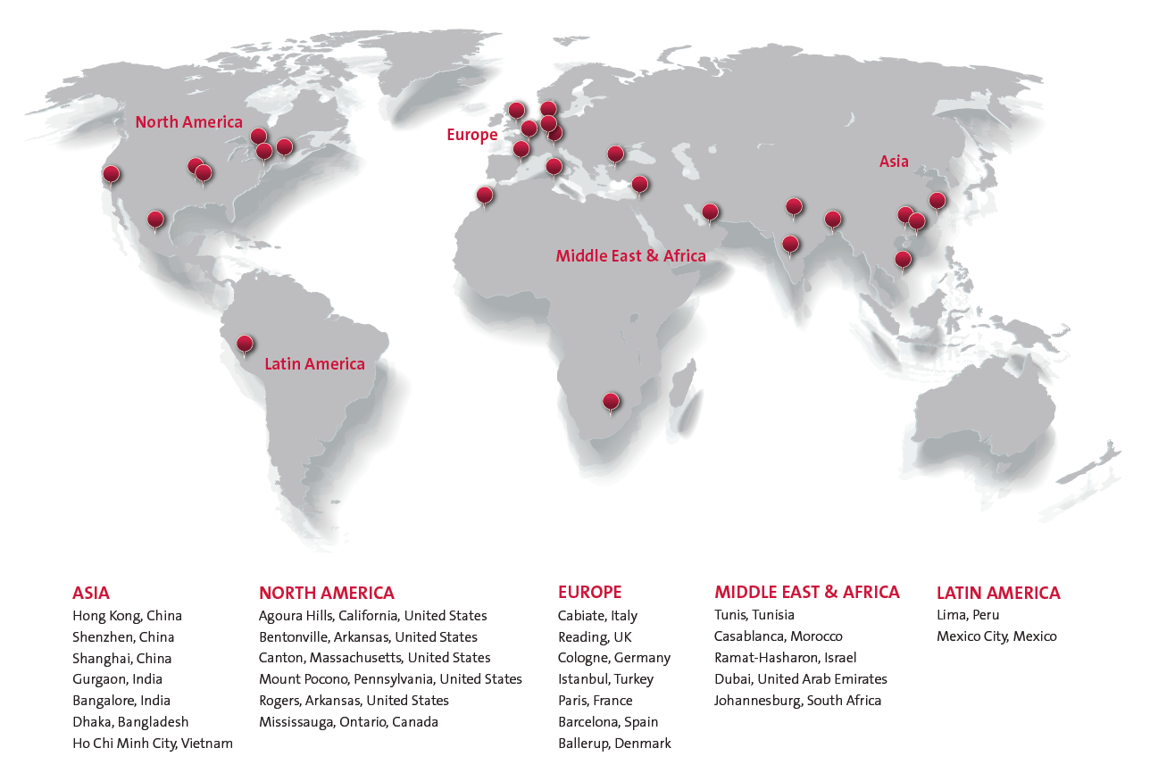
UL CRS – OUR GLOBAL FOOTPRINT

Slide 7
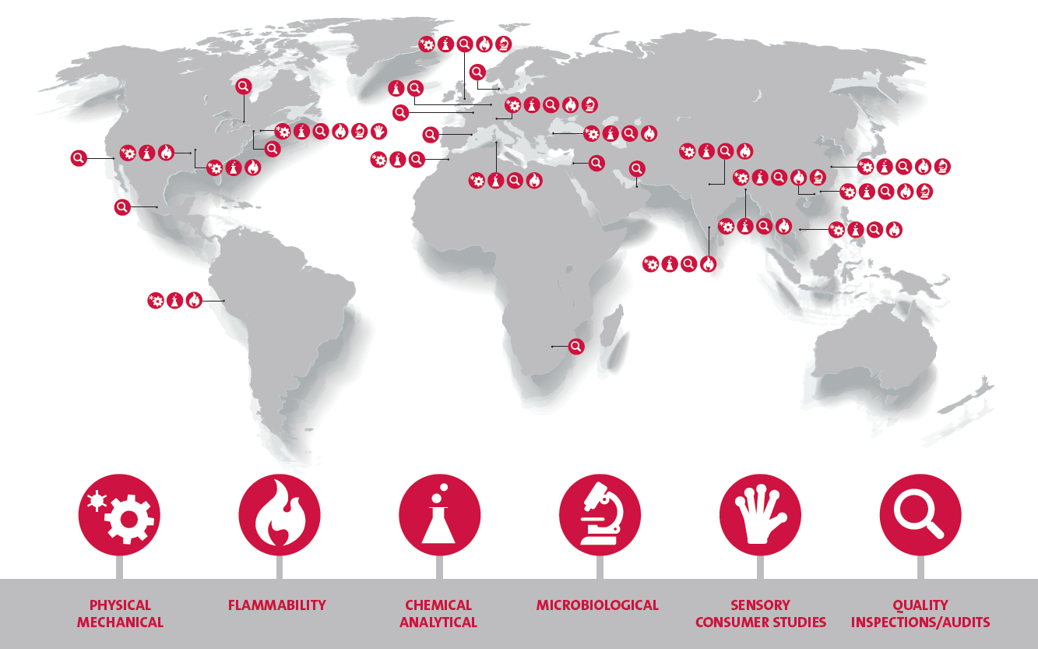
UL CRS – OUR GLOBAL CAPABILITY

Slide 8
Agenda
About UL
Jewelry Division
RJC Auditing Process
Resources
UL Apps

Slide 9
UL CRS – OUR GLOBAL FOOTPRINT
UL Jewelry Division
50,000
270+
30+
Fine, Children’s and Fashion Jewelry items tested annually
Social Auditors Globally
Nationalities and languages represented by our staff
Within UL’s network of laboratories, UL maintains three Jewelry Centers of Excellence
Bentonville, Arkansas, USA
Shenzhen, China
Reading, UK (coming soon!)
4,000
120+
20,000+
Fine Jewelry Product Inspections conducted annually
Countries covered by our global auditing footprint
Assessments conducted each year

Slide 10

UL jewelry division
In 2009 UL established the UL Global Jewelry Division
Master Gemologist Appraisers, Certified Gemologist Appraisers, Diamond Cutters, Graduate Gemologists, Diamond Graduates and Accredited Jewelry professionals
PROTECTING YOUR GOODS
AND YOUR GOOD NAME
Notes:
“You might not have known but we have been servicing the jewelry industry for a very long time, we have been testing children products including jewelry to ensure it’s safety for over 30 years and we were actually the first organization to conduct an RJC certification in 2005. Safety has evolved since 1894 and UL has evolved within an ever-changing world and in order to maintain relevant and on the forefront of the ever changing technology and needs of the jewelry industry, UL recognized that we needed the expertise of the jewelry industry and established our jewelry division. ….”

Slide 11




UL jewelry division
Solutions
TESTING & QUALITY ASSURANCE
Chemical and Analytical Services
Component Testing
Physical Evaluation
Performance Assessment
AUDITS & ASSESSMENTS
Factory Capability
Social Assessment
Management Systems Analyses
INSPECTIONS
Top of Production (TOP) Inspections
In-Process Quality Checks (IPQC)
Final Random (FRI)/Pre-Shipment (PSI) Inspections
Loading Inspections
Production Monitoring
RESPONSIBLE SOURCING SOLUTIONS
Program Development and Management
Monitoring Services
Capacity Building, Training & Education

Slide 12
UL jewelry division / EXISTING FRAMEWORKS
EICC-GeSI Conflict Free Smelter Program (“CFS Program”)
Responsible Jewellery Council (RJC)
London Bullion Market Association (LBMA) Responsible Gold Good Delivery Refiner audits
Fairmined Standard for Gold from Artisanal Mining
Fairtrade Standard for Gold
Dubai Multi Commodity Centre (DMCC) Program
Alliance for Responsible Mining
Diamond Development Initiative (DDI)
ASM-PACE Artisanal and Small Scale mining In/Around Protected Areas and Critical Ecosystems
Initiative for Responsible Mining Assurance
International Council on Mining and Metals

Slide 13

UL jewelry division / EXISTING FRAMEWORKS
OECD Due Diligence Guidance
5 Step Due Diligence Framework:
  Establish strong company management systems
  Identify and assess risks in the supply chain
  Design and implement a strategy to respond to identified risks
  Carry out independent third-party audit of supply chain due diligence at identified points in the supply chain
  Report on supply chain due diligence

Slide 14
UL jewelry division / EXISTING FRAMEWORKS
OECD Framework / Program Development
Country of Origin Inquiry
Program Set-up
Risk Management
Systems Gap Assessment
Communication with Suppliers
Supply Chain Risk Assessment
Policy Development/ Revision
HQ and Supplier Trainings
Risk Mitigation Strategy
Verification
Prioriziation
Capactiy Building & Continuous Improvement

Slide 15

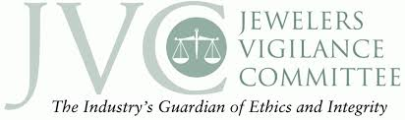







UL jewelry division
Affiliations and Memberships
Notes:
Joined UL was amazed to see the full scope of services within each area of UL that services the jewelry industry – brochures
This is a branded industry – building a brand and credibility takes time
AGS – Guilds, Sponsorship of Conclave
IDCA – Diamond Industry
RJC – Responsible Sourcing Division – UL was first auditing firm to conduct RJC certifications – still sit on the Board of Standards
FJATA –
JVC –

Slide 16
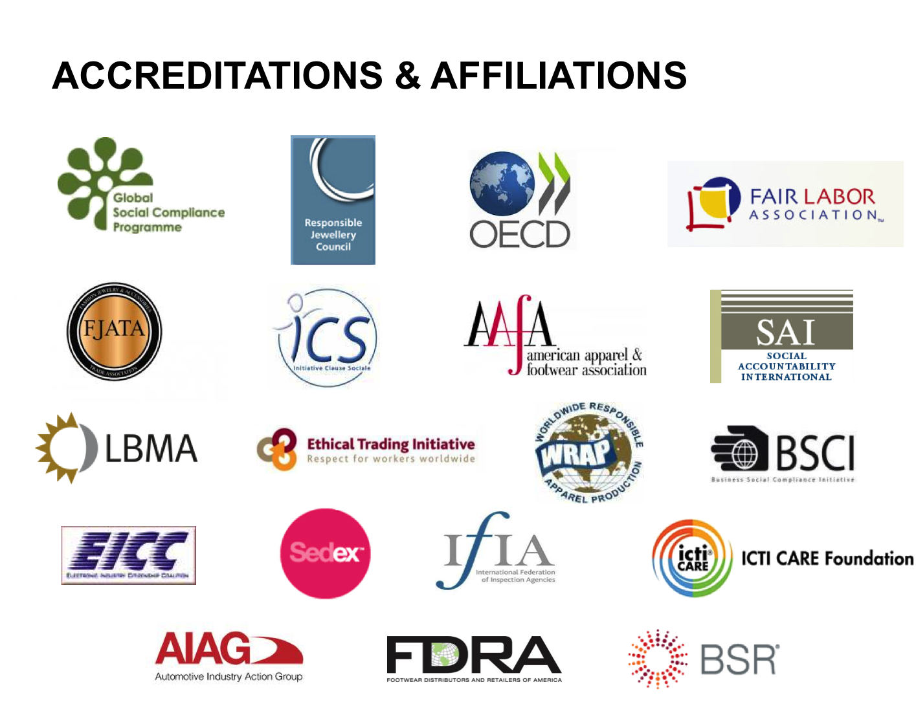
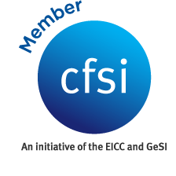


UL jewelry division
Focus on Key Initiatives and Standards
Notes:
What are your end customers requiring?
Focus on social compliance only?
Also looking at conflict minerals?

Slide 17
UL jewelry division
Third-Party Assessment / What to Expect
Project scoping
Opening meeting
Management interviews
Employee interviews
Site walkthrough
Documentation review
Closing meeting
Agenda confirmation
Notes:
Opening Meeting: The lead auditor meets with facility management to review the policies and procedures for on-site assessment. This includes describing the scope of the assessment, identifying parties involved, and estimating the assessment duration. UL’s Statement of Integrity is presented to management and signed by both parties.
Document Review: Auditors review documentation to identify non-compliances.. Auditors request and review documents including licenses, written policies, personnel files, payroll and working hour documentation, collective bargaining agreements and employment contracts, and EHS records.
Employee Interviews: Interviews with workers and management provide insight into actual workplace conditions. Worker selections for interviews are made so that a representative sample of the workforce is captured. Employee interviews are conducted in a private room with no management present and are confidential; however, workers can opt out should they choose not to participate.
Facility Walkthrough: Auditors conduct a walkthrough of all areas where workers may be present including: production floors, warehouses, chemical storage units, dormitory, lavatories, clinic, canteen, and nursery. A health and safety manager generally accompanies auditors, or someone equipped to answer questions about the safety practices at the facility. Human Resource staff members are also often present to answer questions on HR policies that may arise from observations. Photos are taken during the walkthrough to capture findings and general layout of the work floors, dormitories, canteen, warehouses, etc.
Closing Meeting: Immediately following a workplace assessment, UL shares a summary of non-compliances directly with the facility. Management is asked to sign off on the summary report. Auditors will assign the facility a rating based on the severity of the findings as laid out in a grading scorecard.
Integrity policy is signed in opening meeting.
Management is forbidden from interfering in the employee interview process through employee coaching, or by speaking with employees post-interview to ask about information provided to the auditor during interviews. Audit team will inform management at time of audit regarding policies regarding employee interview confidentiality.
Auditors are asked to take photos of the general outlook of the work floor and other areas, as well as any potential areas of improvment noted. Auditors do not take photos of confidential production processes or product designs.

Slide 18
Agenda
About UL
Jewelry Division
RJC Auditing Process
Resources
UL Apps

Slide 19
RJC auditing Process I
OPENING MEETING
Reconfirm agenda
Reconfirm attendees
Discuss schedule
Clarify questions regarding basic management systems, where and how documents are maintained
Explanation of integrity policy
Reaffirmation of confidentiality policy
MANAGEMENT INTERVIEW
Review Workbook responses
Gather basic information for report writing purposes
Pose questions regarding system implementation
Triangulation – Connect management system documentation of the auditee with requirements

Slide 20
RJC auditing Process II
DOCUMENT REVIEW
Review Workbook responses
Select samples of documentation for review purposes
Review policies and implementation documentation
Review contracts, time records, payrolls, health and safety documentation
Connect management system documentation of the auditee with requirements
PRIVATE EMPLOYEE INTERVIEWS
Auditor selects employees
Private space needed
Auditor reassures employees of confidentiality
Management should not attend
Questions are simple – there is no “wrong” answer
Auditee should assist in making employees feel comfortable, explaining the purpose of the interviews

Slide 21
RJC auditing Process III
FACILITY WALKTHROUGH
Focuses on understanding operations onsite and workplace safety
Does not focus on product specifications or other confidential matters
Auditors may wish to take photos to document health and safety areas of improvement – particularly useful to show continuous improvement
CLOSING MEETING
Expression of gratitude for cooperation in a smooth assessment
Reiteration of the good practices in place at the auditee
Review of any areas open to potential improvement
Note: Not a time for disclosure of new findings, discussion about confirmed findings

Slide 22
Agenda
About UL
Jewelry Division
RJC Auditing Process
Resources
UL Apps

Slide 23
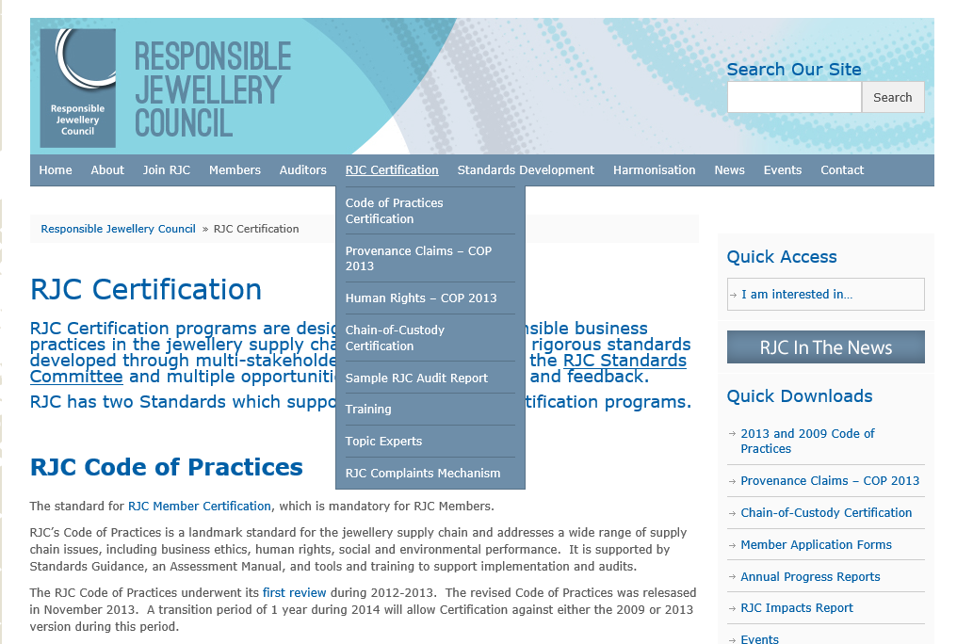
AVAILABLE RESOURCES I

Slide 24
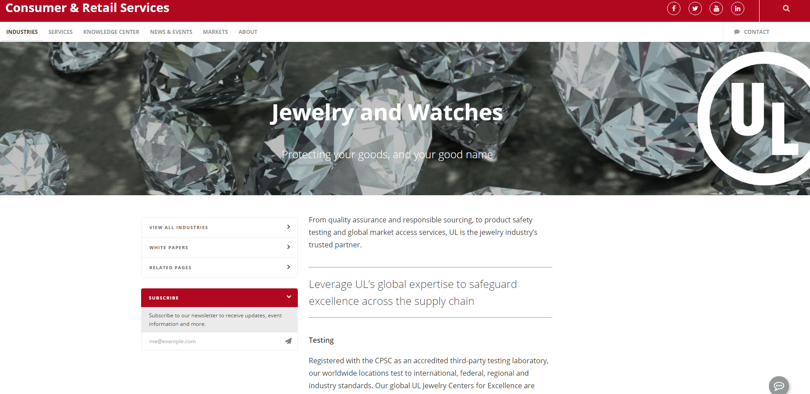
AVAILABLE RESOURCES II

Slide 25
Why UL is Here
The mission
Responsible sourcing and traceability
Changing of mentality
Transparancy
Notes:
We at UL are aware that the Responsible Sourcing is essential for this Industry. We support CiBJO and agree with the huge mission that this organization is pursuing since long time.
We strongly believe that conducting their own business along the principles of responsible sourcing and traceability, companies are getting acquainted with a new reliable business model: a sort of common language spoken by all the stakeholders.
Responsible Sourcing is not a commercial initiative, even if it can bring benefits. RS is a matter of Changing of Mentality and I know that we all in this room are on the same weivelenght.
And we all have the responsibilty to spread and promote this approach as well.
UL can help the Jewelry Industry on this, driving every single step of the supply chain, promoting and ensuring ethics, disclosure and transparency and this is the reason why.

Slide 26
Agenda
About UL
Jewelry Division
RJC Auditing Process
Resources
UL Apps

Slide 27

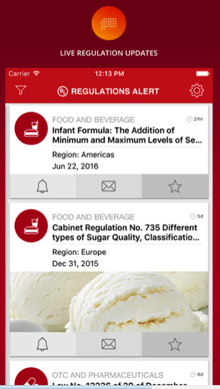
UL REGALERT
Download Our Mobile APP
UL’s New mobile application
delivers up-to-date regulatory
developments and news
impacting the global consumer
products industry
iTunes: https://goo.gl/PvV3mf
Google Play: http://goo.gl/5gpTlV

Slide 28

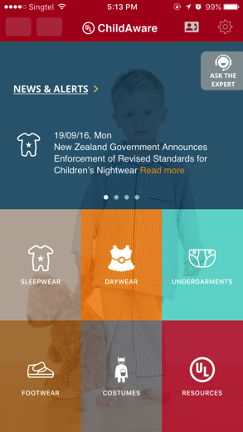
UL ChildAware™
Download Our Mobile APP
UL’s New mobile application delivers valuable regulatory developments and up-to-date news impacting the global children’s apparel industry.
iTunes: https://goo.gl/kpHsPG
Google Play: https://goo.gl/5xRqgW

Slide 29
THANK YOU.
Daphne.M.Guelker@ul.com
Francesca.Angeloni@ul.com
UL fosters safe living and working conditions for people everywhere through the application of science to solve safety, security and sustainability challenges. The UL Mark engenders trust enabling the safe adoption of innovative new products and technologies. Everyone at UL shares a passion to make the world a safer place. We test, inspect, audit, certify, validate, verify, advise and train and we support these efforts with software solutions for safety and sustainability. To learn more about us, visit UL.com/crs.
UL.com/crs

