Slide 1
Defending the Integrity of Jewellery’s Supply Chain
VICENZAORO
Sunday, January 22, 2017

Slide 2
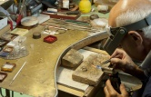
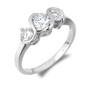
WORKPLACE
PRODUCT
JEWELLERY SUSTAINABILITY
SOCIAL RESPONSABILITY
ETHICS
SUPPLY CHAIN
ENVIRONMENT
CONNECT WITH

Slide 3
Defending the Integrity of Jewellery’s Supply Chain
THANK YOU!!!
VICENZAORO
Sunday, January 22, 2017

