Slide 1
Millennials – consumers with a sense of purpose
VVicenza 2016
Costantino Papadimitriou
SVP Brand Strategy&Innovation
Forevermark
Notes:
Opportunity to share some of our thinking on Millennials
A much discussed segment of the population
And while our targets are often more than just Millennials, I believe it is important that we fully consider the impact this segment will have upon all that we are doing.
So I’d like to spend the next short while sharing some learning and insights on Millennials with a global perspective
At the end I will ask Molly to come up and share some examples of brands that are connecting effectively with Millennials

Slide 2
MULTIPLE STUDIES & RESEARCH PAPERS ANALYSED
ZO: PURSUIT OF HAPPINESS
KEY STUDIES
BOUDOIR SESSIONS
300 millennials
in 10 Cities
CONE COMMS
MILLENIAL CSR STUDY:
1003 people aged between 18-34
PANEL SURVEY
5,000 online panel interviews
MSL
BIG BUSINESS & MILLENNIALS:
5,000 online panel interviews
LIVE MY LIFE
50 in-depth face-to-face interviews
OTHER SOURCES
BBH & GFK Millennial Values Study 2015
JWT – Meet the Bric Millennials/Positive Luxury
Notes:
[‎02/‎02/‎2016 11:30] Matthew Morgan:
leveraging the interests of the 99% to increase visibility within the 1%
put that in notes

Slide 3
Who are Millennials? What is important to them?

Slide 4
Millennials – A recap
Millennials as % of each country’s population
Cohort aged approx. 18-35 (born early 1980s to early 2000s)
Preceded by Generation X, Baby Boomers before that
Make up around a quarter of world’s population today, and more in developing markets
Notes:
In US just over-taken the next largest group Boomers – 77m in US
Approx 350m in India, 400m in China, 24 m in Japan
So this is a large cohort who will play a significant role in shaping the future world around us

Slide 5
Value, Quality & Customer Service
$200b in purchasing power and another $500b thorough indirect spending by influencing their parents

Slide 6
Value, Quality & Customer Service
By 2017, Millennials will outspend Baby Boomers

Slide 7
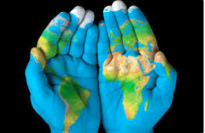
Millennials – Key Facts
More ‘Global’
Notes:
LESS DEFINED BY BORDER OR GEOGRAPHIC LOCATION
TAKE INFLUENCE AND INSPIRATION FROM AROUND THE WORLD, BEYOND THEIR LOCAL COMMUNITY
FIND PEERS ANYWHERE/EVERYWHERE – LIKE- MINDED INDIVIDUALS WHO SHARE THEIR PASSIONS AND INTERESTS
CLEARLY LOCAL CUSTOMS AND TRADITIONS REMAIN IMPORTANT BUT INCREASINGLY INTERESTS AND VALUED ARE SHARED AROUND THE WORLD BY MILLENNIALS

Slide 8
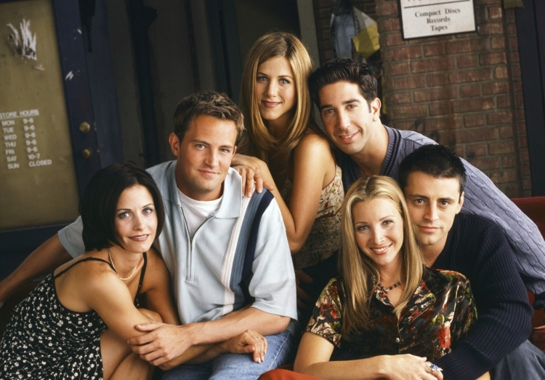
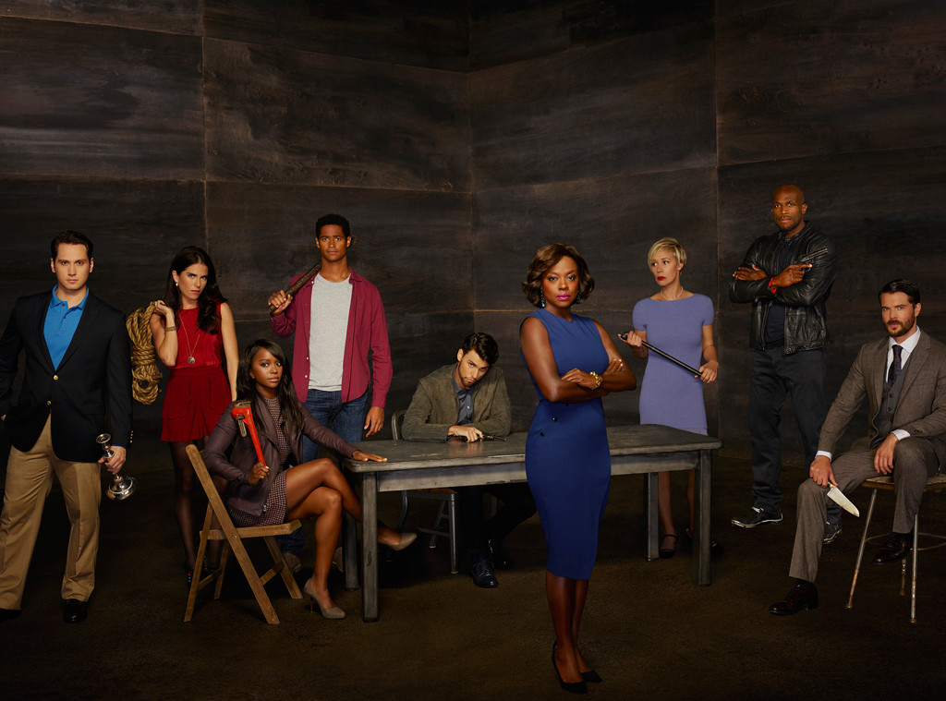
And,.... They don’t notice diversity, they notice when its missing
1994 – 2004
Friends
2014 –
How to get away with murder

Slide 9
Millennials – Key Facts
More ‘Global’
More Educated
Notes:
THIS IS AN EDUCATED GROUP
A 25 YEAR OLD TODAY IS TWICE AS LIKELY TO BE EDUCATED TO A HIGHER LEVEL THAN THEIR PARENTS GENERATION
WITH THIS COMES AN INCREASINGLY SAVVY AND SOPHISTICATED CONSUMER WHO IS ABLE TO UNDERSTAND A BRAND’S STRATEGY- THEY ARE INCREASINGLY ABLE TO SEE THROUGH MARKETING
WE NEED TO BE ATTUNE TO THIS AND ENSURE WE ARE TRANSPARENT, AUTHENTIC IN ALL THAT WE DO. THEY WANT TO FIND SHARED VALUES

Slide 10
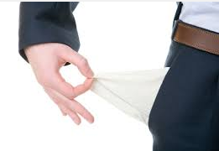
Millennials – Key Facts
More ‘Global’
More Educated
More Financially challenged
Notes:
MONEY IS OFTEN TIGHTER FOR MILLENNIALS THAN PREVIOUS GENERATIONS
WHILE GREATER EDUCATION CAN LEAD TO INCREASED SALARIES, THE COST OF LIVING HAS INCREASED DRAMATICALLY WITH DEBT, COST OF HOUSING AT HIGH LEVELS
MILLENNIALS ARE OFTEN DESCRIBED AS A GROUP THAT ARE ‘NOT RICH YET’
THIS WILL MEAN THAT MILLENNIALS WILL SEEK OUT BRANDS THAT BRING THEM VALUE AS IN REALLY UNDERSTANDING THE TRUE VALUE OF AN ITEM

Slide 11
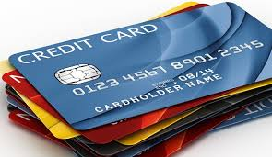
Aversion to Credit Card Usage

Slide 12
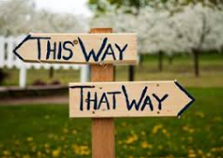
Millennials – Key Facts
More ‘Global’
More Educated
More Financially challenged
Facing more uncertainty and periods of rapid change
Notes:
Almost no economic growth in western markets, slower growth in MORE developing markets
Periods of change, economic and environmental uncertainty

Slide 13
Millennials – Key Facts
More ‘Global’
More Educated
More Financially challenged
Facing more uncertainty and periods of rapid change
Greater opportunities for Freedom of Expression
Notes:
MILLENNIALS HAVE GROWN UP WITH A CONFIDENCE TO BE WHO THEY WANT TO BE AND TELL THE WORLD ABOUT IT
THERE ARE NOW MANY WAYS TO EXPRESS THE PERSON YOU ARE. BUT STILL APPLYING FILTERS TO THE OUTSIDE WORLD
THE BEST THEM, THE PERFECT THEM
MOLLY WILL TALK ABOUT INTERESTING DEVELOPMENTS IN SOCIAL MEDIA AROUND APPS LIKE SNAPCHAT

Slide 14
Millennials – Key Facts
More ‘Global’
More Educated
More Financially challenged
Facing more uncertainty and periods of rapid change
Greater opportunities for Freedom of Expression
Grown up as Digital Natives
Notes:
They know nothing different
TECHNOLOGY ALLOWS MILLENNIALS TO STAY IN CONTROL OF THEIR LIVES – to be the best they can be
But it is important to remember that they put real value face to face interaction. From our perspective young consumer still shop, still want to go in store and experience the product and brand
An interesting example is the recent opening of the Amazon store in Seattle (and more planned)

Slide 15
2
Two hours a day

Slide 16
68%
Consider as personal device

Slide 17
89%
Messaging

Slide 18
80%
Social networking-Instagram-Snapchat-Facebook-Google-less Twitter

Slide 19
75%
Find out more about brands – their reputation/cool factor and price

Slide 20
65%
To find expert advice

Slide 21
90%
Physical stores and ecommerce are seamless, and they the channels to be integrated

Slide 22
Millennials – Key Facts
More ‘Global’
More Educated
More Financially challenged
Facing more uncertainty and periods of rapid change
Greater opportunities for Freedom of Expression
Grown up as Digital Natives
More Socially (and Environmentally) Conscious
Notes:
MILLENNIALS INCREASIGLY SEE THEMSELVES AS SOCIALLY PROGRESSIVE, TOLERANT AND HAVING A SOCIAL and environmental CONSCIENCE
HAVE GROWN UP WITH THIS
TAUGHT IN SCHOOLS
NOW THE NORM
They have strong values
MAY STRUGGLE TO PUT INTO PRACTISE

Slide 23
Value, Quality & Customer Service
Millennials are twice as likely to buy from brands with social and environmental good

Slide 24
Who are Millennials? What is important to them?

Slide 25
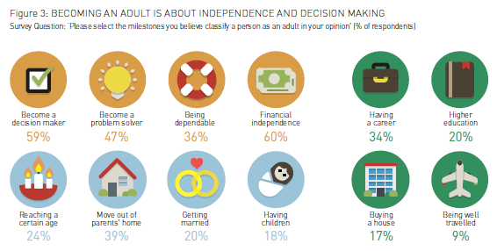
A NEW DEFINITION OF WHAT’S IMPORTANT
“Adulthood is increasingly about achieving independence and pursuing personal goals”
Traditional milestones of adulthood create identity but are no longer the main identifiers

Slide 26
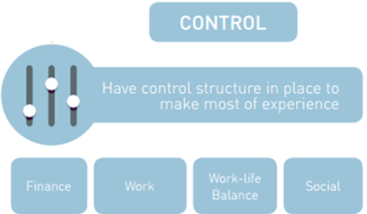
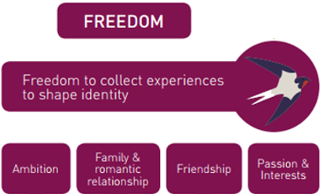
“For millennials, if you are not being the best version of yourself you can’t share with others”
HAPPINESS
“The freedom to pursue something meaningful and the control to make it last”
*A ZenithOptimedia (Performix) study into the ‘Pursuit of Happiness: Creating Meaningful Brand Experience for Millennials’ 2015

Slide 27
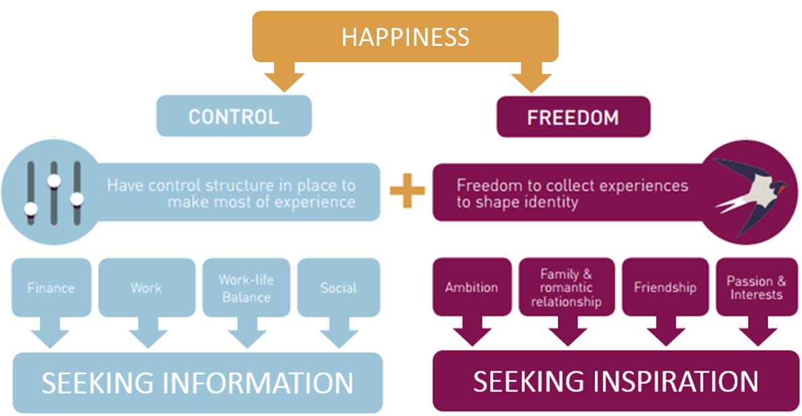
“For millennials, if you are not being the best version of yourself you can’t share with others”
“The freedom to pursue something meaningful and the control to make it last”
*A ZenithOptimedia (Performix) study into the ‘Pursuit of Happiness: Creating Meaningful Brand Experience for Millennials’ 2015

Slide 28
To live with a sense of purpose
“When the crisis began, I found myself
jobless, and I reinvented myself.”
They strive for happiness
To make the most of their lives
Having meaningful experiences (beyond just possessions)
Living with purpose to be the best they can be and defining their own journey through life
Notes:
There is a lot written about experiences and millennials and these are important.
“When the crisis began, I found myself jobless, and I reinvented myself.”

Slide 29
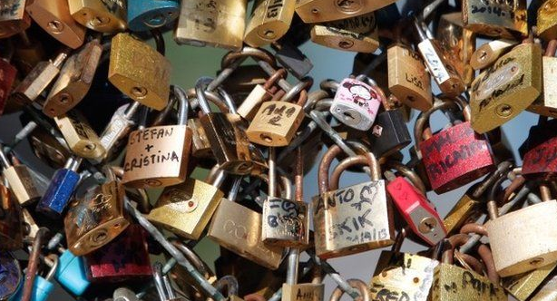
Love is Alive and Kicking
Millennials continue seek love, intimacy, commitment
But increasingly need to be sure of who they are first before ‘taking the plunge’
Love on their own terms, a new rituality is emerging
Less defined by:
Tradition
Family
Gender
Technology playing a key role in shaping this
But still underpinned by commitment, depth of intimacy
Something certain in an uncertain world
And symbols of commitment and love remain important
Notes:
Still long for intimacy but in a new way, fewer rules and boundaries
Significantly more open-minded
Often delaying to ensure they put forward their best selves (and often delaying marriage for the same reason as well as for financial security)
SO IN FACT 25 YEAR OLD MILLLENNIALS ARE HALF AS LIKELY TO BE MARRIED THAN 25 YEAR OLDS IN THEIR PARENTS GENERATION
IMPLICATION
NEED TO continue to present diamonds in a way that is compelling, relevant
MARRIAGE RATES IN DECLINE

Slide 30
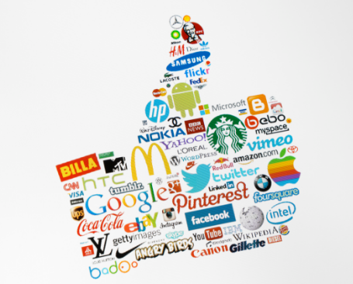
Millennials and Brands
Use brands to shape their world, to define them, their identity and character
They seek out brands with meaning and shared values
They will challenge brands, interrogate them, question them
They will share these experiences, good or bad
They expect brand to act with integrity, with honesty, openness
Notes:
Brands as reference points
They crave insight and information about brands to allow them to make informed decisions
They connect with brands that support causes that are important to them
Millennials use brands to shape their world, their identity and character, to help guide them through an uncertain world
They seek out brands with meaning and shared values and expect brands to understand them and their needs,
They will challenge brands, question them, interrogate them, scrutinise them (and share these experiences, good or bad)
They expect brands to act with integrity, honesty, openness and sustainability

Slide 31
The freedom and inspiration to pursue self-discovery is key
They crave insight and information, develop personal innovation and pursue their dreams and ambitions
Happiness comes from freedom and control
More engaged with Corporate Social Responsibility, and it is impacting their brand allegiance

Slide 32
THANK YOU

